Slide 1
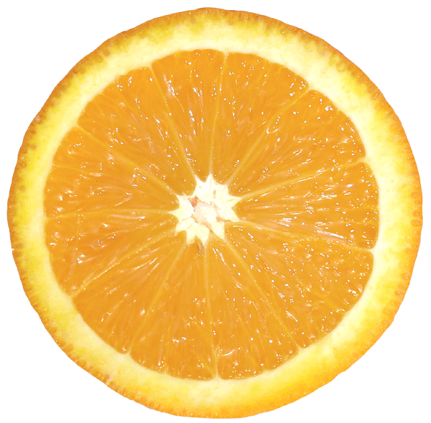
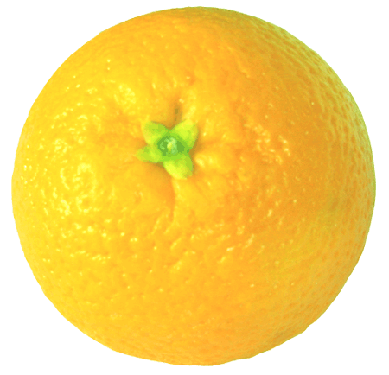
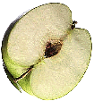
Oranges and Apples

Slide 2
Types of Orange
Tangerine
Satsuma
Clementine

Slide 3
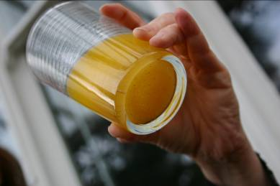
Fresh Orange Drink

